Slide 1

Software Engineering
Software Project Management, Architecture & Design
Software Project Management
Department of Computer Science and Engineering
Acknowledgement: Dr. Phalachandra HL, Prof. Anand MS, authors of the prescribed textbooks and materials sourced online.

Slide 2

Software Project Monitoring ,Control and Closure
List of Contents
Project Monitoring and Control
Dimensions of Project Monitoring and Control
Project Closure
Department of Computer Science and Engineering

Slide 3
Project monitoring & control
What is Project Monitoring and Control?
Project Monitoring and Control includes those processes performed to observe project execution so that potential problems can be identified in a timely manner and corrective action can be taken, when necessary, to control the execution of the project
Project control activities involves making decisions or adjustments in dimensions like time, cost, organizational structure, scope etc. for the project under execution
Dimensions
Time
Cost & Infrastructure
Information
Quality
Organization

Slide 4
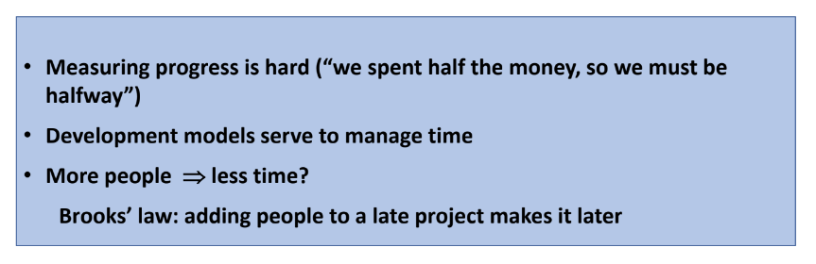
Dimension – Time
In terms of effort (number of man-months) and the schedule

Slide 5
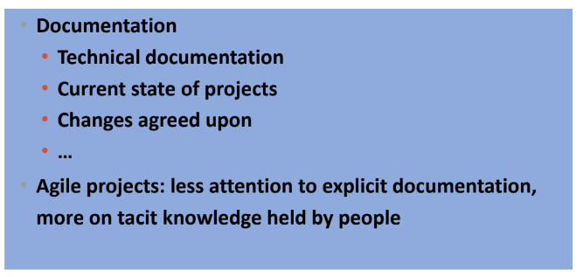
Dimension – Information
Includes availability, propagation, communication and documentation

Slide 6
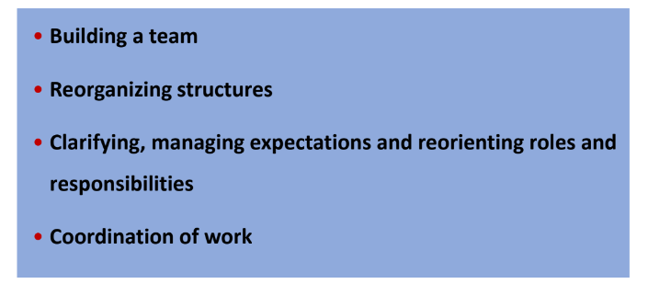
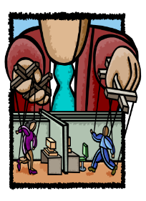
Dimension – Organization
Involves structure, roles & responsibilities from people and team aspects

Slide 7
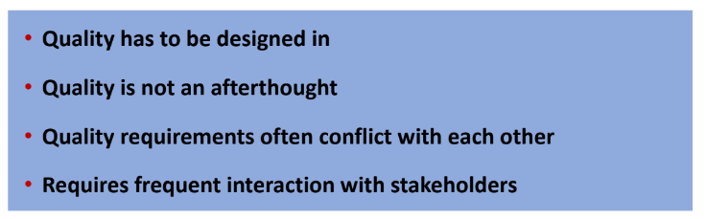
Dimension – Quality
Quality is not an add-on feature; it has to be built in
A leading indicator informs business leaders of how to produce desired results
A lagging indicator measures current production and performance

Slide 8
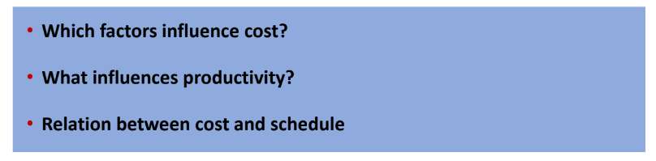
Dimension – Cost & Infrastructure
Includes personnel, capital and expenses

Slide 9
Project management & control
Project monitoring and control process could include:
Monitoring and controlling project work
- Collects, measures and disseminates performance information, assess trends to identify
potential items requiring corrective action or monitoring for risks.
- This can result in corrective or preventive actions and request for changes
- Periodically do Critical Path Analysis
Ensuring that all of the change controls are being meticulously followed
Ensuring that all of the scope, deliverables, documents are periodically updated with the
project plans.
Controlling the Quality triangle
Managing the project team, performance management and communication management

Slide 10
Project Closure
Project closure is the last phase of a project. It’s when the project manager verifies that the client, stakeholder or customer has accepted the project deliverables.
Steps to Closing a Project:
1. Evaluate Your Project
2. Complete Paperwork
3. Release Resources
4. Archive Documents
5. Celebrate Success

Slide 11
THANK YOU
Software Project Management
Department of Computer Science and Engineering
‹#›

